Slide 1
Augmented Reality
Instructor:
Prof. Lee Byung Gook
Student:
Ph.D. Kamolov Ahmadhon
Subject:
Computer Vision

Slide 2

Agenda
Self Introduction
Research Topic
Augmented Reality
Source Code & Result

Slide 3

Self Introduction
Education Tashkent University of Information Technologies 2010-2014
B.Sc Information Technologies
Tashkent, Uzbekistan
GPA is 4.1/4.5
Dongseo University 2016-2018
M.Sc Ubiquitous IT
Busan, South Korea
GPA is 4.28/4.5
Dongseo University 2018-Current
Ph.D. Computer Engineering
Busan, South Korea
GPA is -

Slide 4
Research Topic
Advisor Professor Su-Hyun Park
Research Activities: Artificial Intelligence, Maritime ICT, Convergence
Research Ph.D. Kamolov Ahmadhon
Area Marine IT, Internet of Things, Smart Ships and Smart Ports,
Artificial Intelligence
Interested Machine Learning, Deep Learning, Computer Vision
Topic

Slide 5
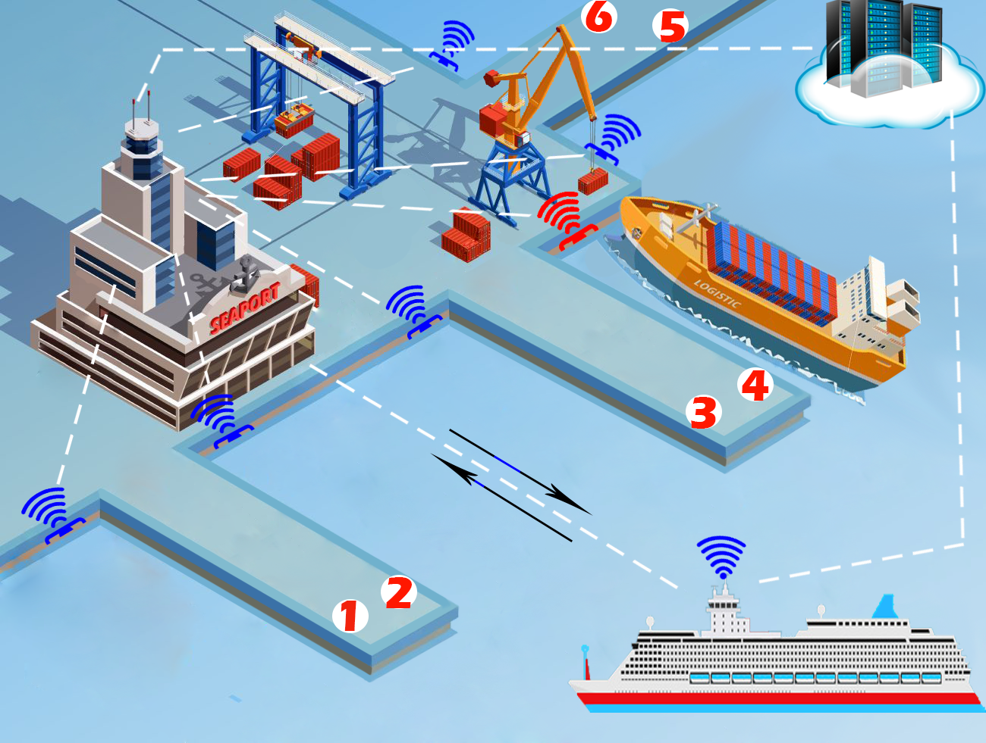
Research Topic
IoT BASED SMART BERTHING (PARKING) SYSTEM FOR VESSELS AND PORTS

Slide 6
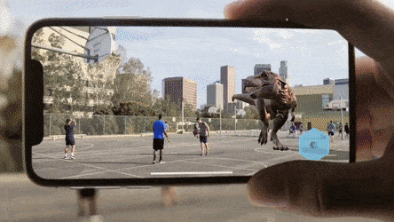
Augmented Reality
What is AR?
How does Augmented Reality work?
Types of Augmented Reality
Augmented reality devices
Augmented Reality Apps Examples
Python(Jupyter Notebook) Example
Result (Video)
Summary

Slide 7
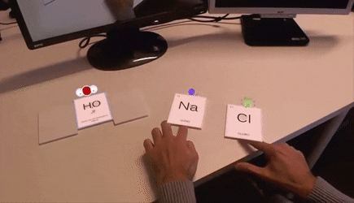
What is AR?
Augmented reality is the technology that expands our physical world, adding layers of digital information onto it. Unlike Virtual Reality (VR), AR does not create the whole artificial environments to replace real with a virtual one. AR appears in direct view of an existing environment and adds sounds, videos, graphics to it.

Slide 8
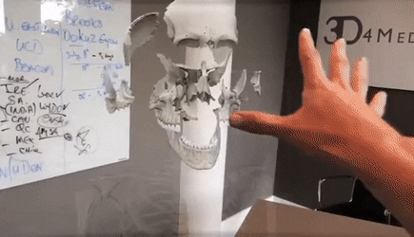
How does Augmented Reality work?
AR can be displayed on various devices: screens, glasses, handheld devices, mobile phones, head-mounted displays. It involves technologies like S.L.A.M. (simultaneous localization and mapping), depth tracking (briefly, a sensor data calculating the distance to the objects), and the following components:
Notes:
What is Augmented Reality for many of us implies a technical side, i.e. how does AR work? For AR a certain range of data (images, animations, videos, 3D models) may be used and people will see the result in both natural and synthetic light. Also, users are aware of being in the real world which is advanced by computer vision, unlike in VR.

Slide 9
How does Augmented Reality work?
Cameras and sensors. Collecting data about user’s interactions and sending it for processing. Cameras on devices are scanning the surroundings and with this info, a device locates physical objects and generates 3D models. It may be special duty cameras, like in Microsoft Hololens, or common smartphone cameras to take pictures/videos.
Processing. AR devices eventually should act like little computers, something modern smartphones already do. In the same manner, they require a CPU, a GPU, flash memory, RAM, Bluetooth/WiFi, a GPS, etc. to be able to measure speed, angle, direction, orientation in space, and so on.
Projection. This refers to a miniature projector on AR headsets, which takes data from sensors and projects digital content (result of processing) onto a surface to view. In fact, the use of projections in AR has not been fully invented yet to use it in commercial products or services.
Reflection. Some AR devices have mirrors to assist human eyes to view virtual images. Some have an “array of small curved mirrors” and some have a double-sided mirror to reflect light to a camera and to a user’s eye. The goal of such reflection paths is to perform a proper image alignment.

Slide 10
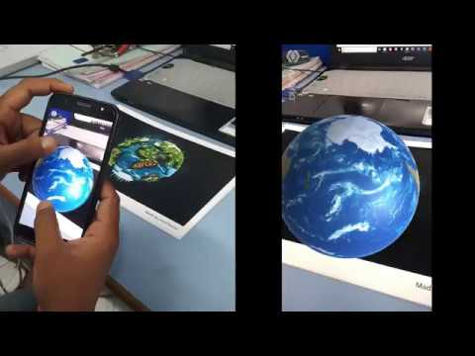
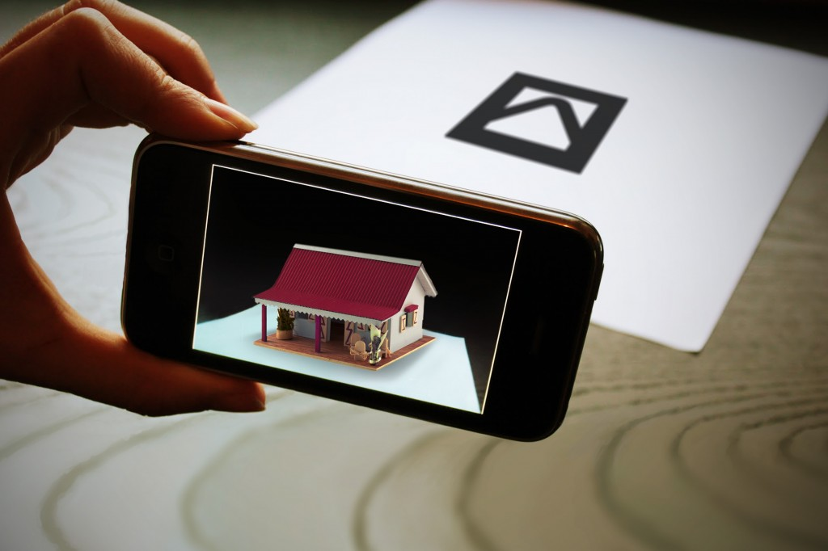
Types of Augmented Reality
Marker-based AR. Some also call it to image recognition, as it requires a special visual object and a camera to scan it. It may be anything, from a printed QR code to special signs. The AR device also calculates the position and orientation of a marker to position the content, in some cases. Thus, a marker initiates digital animations for users to view, and so images in a magazine may turn into 3D models.
Notes:
Marker-based AR: This generally involves tracking a camera against a planar texture pattern, but sometimes also a 3D object. Key algorithms include interest point detection and matching [2], as well as RANSAC to filter out erroneous matches, plus a basic geometric model of the scene, such as a homography or essential/fundamental matrix.

Slide 11
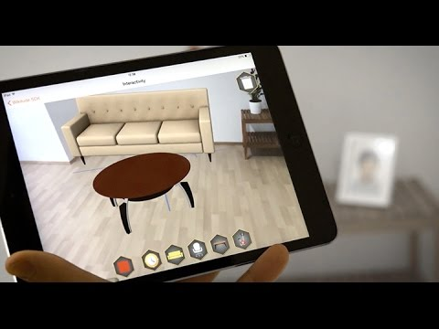
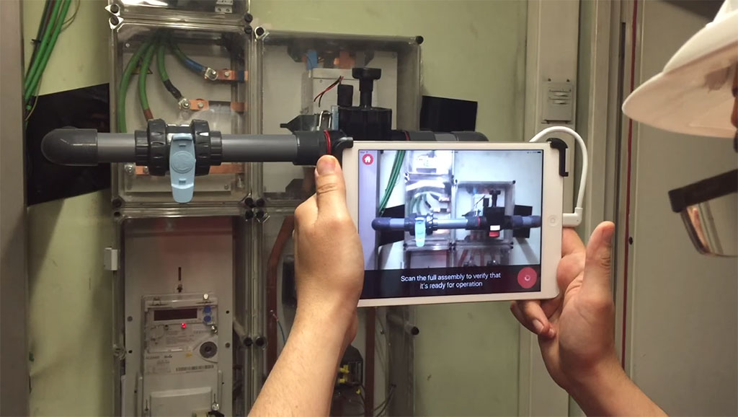
Types of Augmented Reality
Markerless AR. A.k.a. location-based or position-based augmented reality, that utilizes a GPS, a compass, a gyroscope, and an accelerometer to provide data based on user’s location. This data then determines what AR content you find or get in a certain area. With the availability of smartphones this type of AR typically produces maps and directions, nearby businesses info. Applications include events and information, business ads pop-ups, navigation support.
Notes:
Marker-less AR: Here you don’t have to put pre-specified markers in the scene, so the system can run in many environments right out of the box. Key algorithms include visual odometry and visual-inertial odometry.

Slide 12
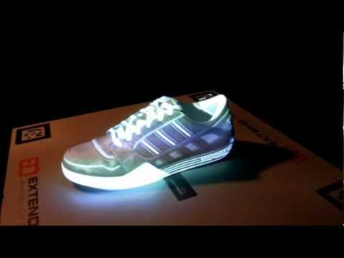
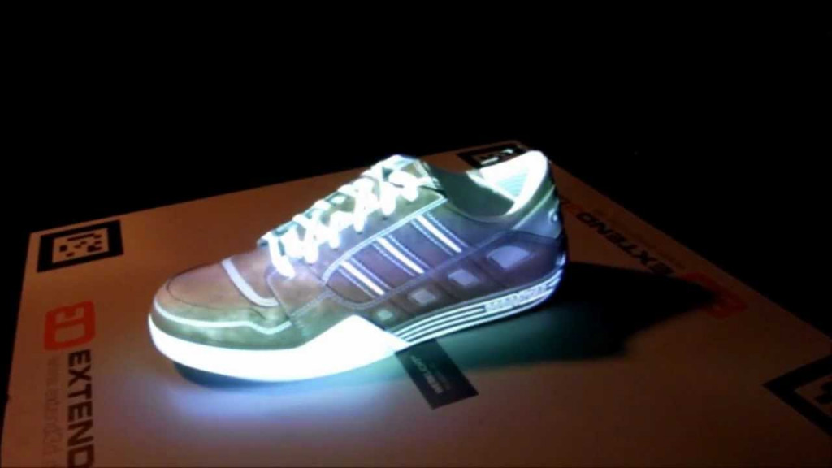
Types of Augmented Reality
Projection-based AR. Projecting synthetic light to physical surfaces, and in some cases allows to interact with it. These are the holograms we have all seen in sci-fi movies like Star Wars. It detects user interaction with a projection by its alterations.

Slide 13
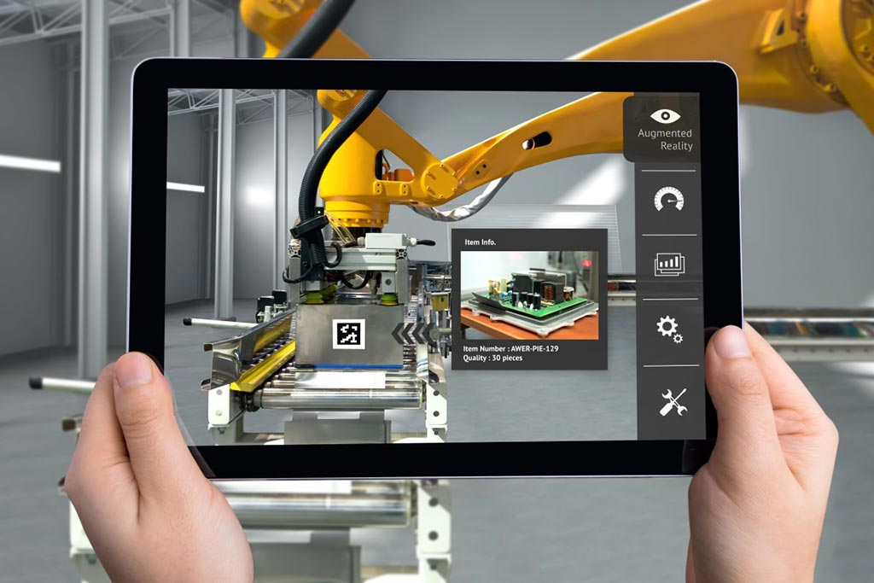
Types of Augmented Reality
Superimposition-based AR. Replaces the original view with an augmented, fully or partially. Object recognition plays a key role, without it the whole concept is simply impossible. We’ve all seen the example of superimposed augmented reality in IKEA Catalog app, that allows users to place virtual items of their furniture catalog in their rooms.

Slide 14
Augmented reality devices
Devices suitable for Augmented reality fall into the following categories:
Mobile devices (smartphones and tablets) – the most available and best fit for AR mobile apps, ranging from pure gaming and entertainment to business analytics, sports, and social networking.
Special AR devices, designed primarily and solely for augmented reality experiences. One example is head-up displays (HUD), sending data to a transparent display directly into user’s view. Originally introduced to train military fighters pilots, now such devices have applications in aviation, automotive industry, manufacturing, sports, etc.
AR glasses (or smart glasses) – Google Glasses, Meta 2 Glasses, Laster See-Thru, Laforge AR eyewear, etc. These units are capable of displaying notifications from your smartphone, assisting assembly line workers, access content hands-free, etc.
AR contact lenses (or smart lenses), taking Augmented Reality one step even farther. Manufacturers like Samsung and Sony have announced the development of AR lenses. Respectively, Samsung is working on lenses as the accessory to smartphones, while Sony is designing lenses as separate AR devices (with features like taking photos or storing data).
Virtual retinal displays (VRD), creating images by projecting laser light into the human eye. Aiming at bright, high contrast and high-resolution images, such systems yet remain to be made for a practical use.
Notes:
Many modern devices already support Augmented reality. From smartphones and tablets to gadgets like Google Glass or handheld devices, and these technologies continue to evolve. For processing and projection, AR devices and hardware, first of all, have requirements such as sensors, cameras, accelerometer, gyroscope, digital compass, GPS, CPU, displays, and things we’ve already mentioned.

Slide 15
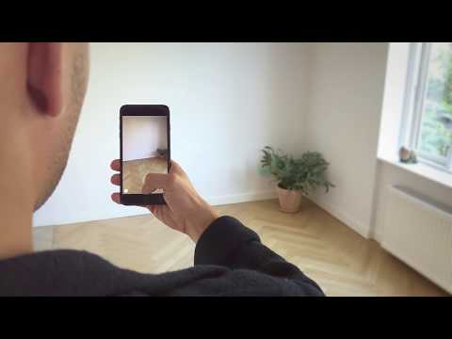
Augmented Reality Apps Examples
#1 IKEA Place app
A successor of Ikea catalog app, the Place app is among the first apps to work with Apple’s ARkit and iOS system. Browsing through the catalog of 2,000 chairs, sofas, tables, and other items, we can use the phone’s camera to place them in a real room as augmented reality 3D objects. Re-positioning, moving closer or further away, different angle view is also possible. The app automatically scales items to real dimensions – Ikea is claiming a 98% rate of accuracy. All in all, a nice example of usability and marketing!

Slide 16
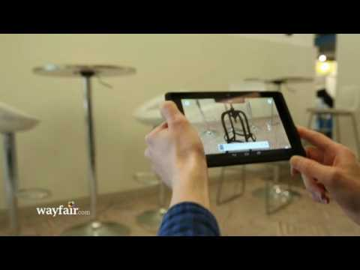
Augmented Reality Apps Examples
#2 Wayfair
A US online furniture and decor retailer Wayfair started working on augmented reality app in 2016. They have been improving it ever since with the help of ARCore by Google. So far, WayfairView app is available for Asus ZenFone and Lenovo Phab 2. This AR app allows customers to view digital images of furniture, and rotate them in different perspectives in real time as well. A great advantage in terms of business benefits is Add-to-cart button that leads to the checkout page right away.

Slide 17
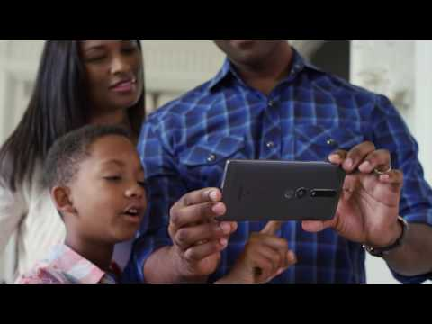
Augmented Reality Apps Examples
#3 Lowe’s Vision
Though it is a beta version yet, Lowe’s Vision app promises rich AR features to let smartphone users place and design 3D imagery in more depth by means of the Tango platform and 2-camera Lenovo phones. Lowe’s partnership with Google Tango is planning to bring augmented reality to a new level. The app also allows accurate measurements in relation to room dimensions.

Slide 18
Python(Jupyter Notebook) Example
https://github.com/ahmadxon/Programming-Computer-Vision-with-Python-Notebook/tree/master/Homeworks/Homework_5

Slide 19

Result (Video)

Slide 20
Result (Video)

Slide 21
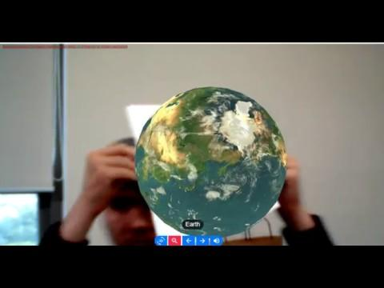
Result (Video)

Slide 22
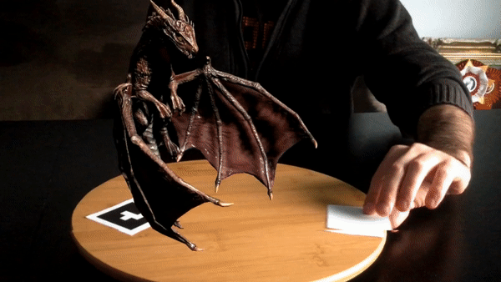
Summary
Augmented Reality suits the furniture business perfectly. People want to see virtual interior design ideas in real time, and AR provides them with such ability. Finally, we want to remind that our developer team at ThinkMobiles also has augmented reality developers, that you can hire. To see what they are capable of, please check MyAR project.

Slide 23
THANK YOU

